Slide 1

6th Grade Math
Unit 12, Lesson 7 Solving One-Step Equations in One Variable Using Addition and Subtraction – Part 1 Volume 2, pg. 313

Slide 2


Benchmark
MA.6.AR.2.2
Write and solve one-step equations in one variable within a mathematical or real-world context using addition and subtraction, where all terms and solutions are integers.
volume 2, pg. 313

Slide 3
Integrated Mathematical Thinking and Reasoning Standards
MA.K12.MTR.1.1 Actively participate in effortful learning both individually and collectively.
MA.K12.MTR.2.1 Demonstrate understanding by representing problems in multiple ways.
MA.K12.MTR.4.1 Engage in discussions that reflect on the mathematical thinking of self and others.
MA.K12.MTR.5.1 Use patterns and structure to help understand and connect mathematical concepts.
MA.K12.MTR.6.1 Assess the reasonableness of solutions.
volume 2, pg. 313

Slide 4

Learning Target
I can solve addition and subtraction one-step equations in one variable using manipulatives, drawings, and number lines to show the inverse operations.
volume 2, pg. 313

Slide 5

Warm-Up
volume 2, pg. 313

Slide 6


12.7.1 Warm-Up: Are They Inverses?
Angelica and Felipe were working on a project in art class. They were given the images below and instructed to explain whether or not the images are inverses.
Image 1 | Image 2
volume 2, pg. 313

Slide 7
Angelica said, “This was just like inverse operations from math class. Inverse means to do the reverse.”
Felipe responded, “But the second image is a smaller image inside of the same image, so it is not a picture of inverses.”
Explain whether you agree with Angelica, Felipe, or both.
How do you see inverses represented in either image?
volume 2, pg. 313

Slide 8

Guided Instruction
volume 2, pg. 314

Slide 9

12.7.2 Guided Instruction: Solving Equations with Inverse Operations
Bar models and balance scales are useful tools for representing equations.
In the bar model shown, each palm tree represents 1 unit.
volume 2, pg. 314

Slide 10
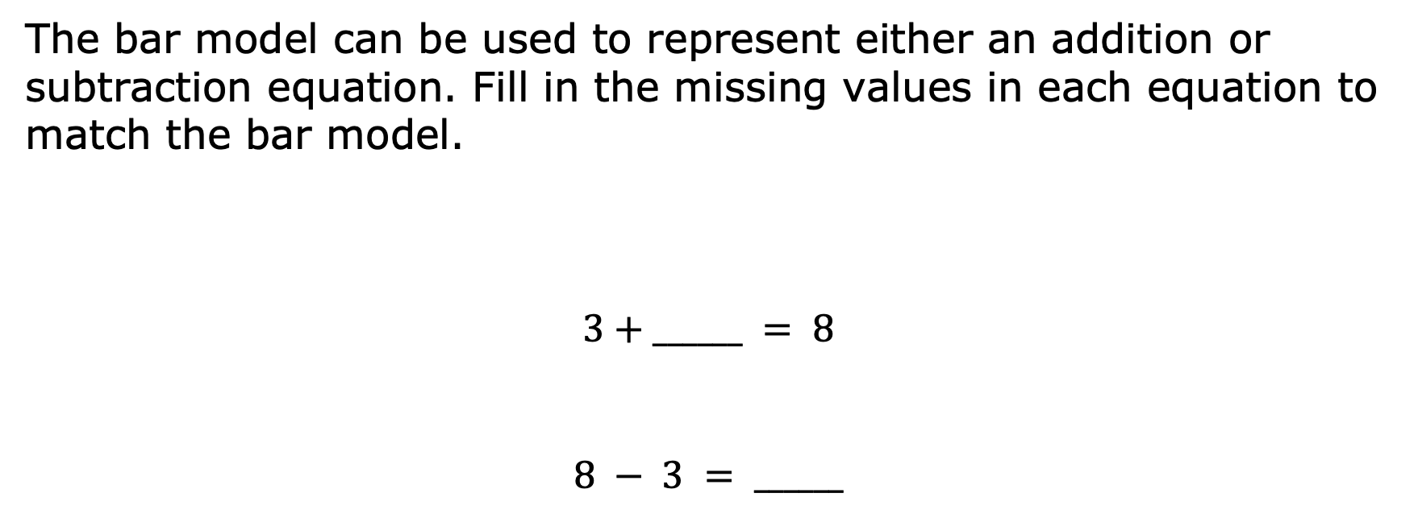
volume 2, pg. 314

Slide 11



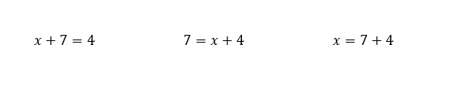
The bar model shown can be used to represent either an addition or subtraction equation.
Circle the addition equation that matches the diagram.
volume 2, pg. 314

Slide 12
Write an equivalent equation using the inverse operation.
Justify to your partner that the equation you wrote is an equivalent equation.
What is the value of the variable, 𝑥?
volume 2, pg. 314

Slide 13
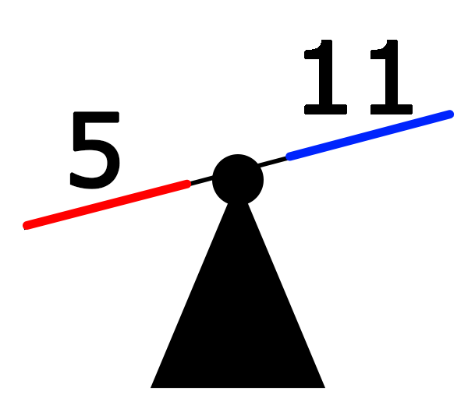
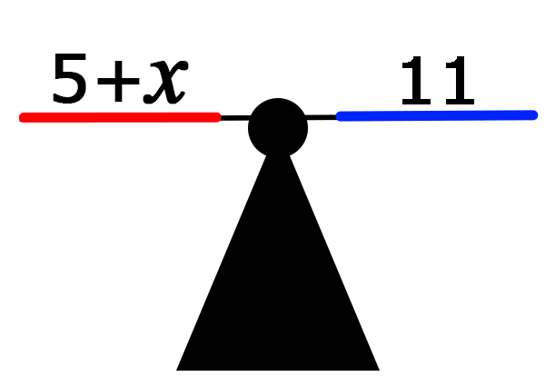




Two balance scales are shown. The scale on the left is unbalanced. To balance the scale, an unknown value, 𝑥, needs to be added to the right side of the scale.
volume 2, pg. 315

Slide 14
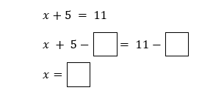
The equation represented by the balance scale on the right is shown. Use inverse operations to find the value of 𝑥 by completing the steps shown.
Rewrite the original equation, substituting the solution for 𝑥.
volume 2, pg. 315

Slide 15
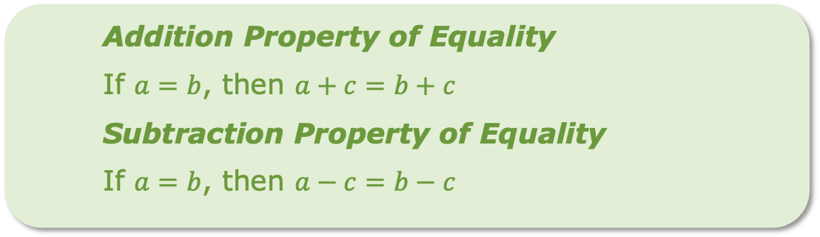

Explain how to use the equation in Part B to confirm that your solution is correct.
Inverse operations can be used to find the value of the variable in an algebraic equation by creating equivalent equations.
volume 2, pg. 315

Slide 16
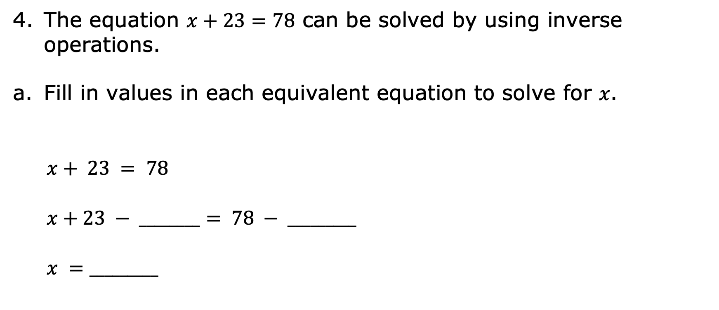
volume 2, pg. 315

Slide 17
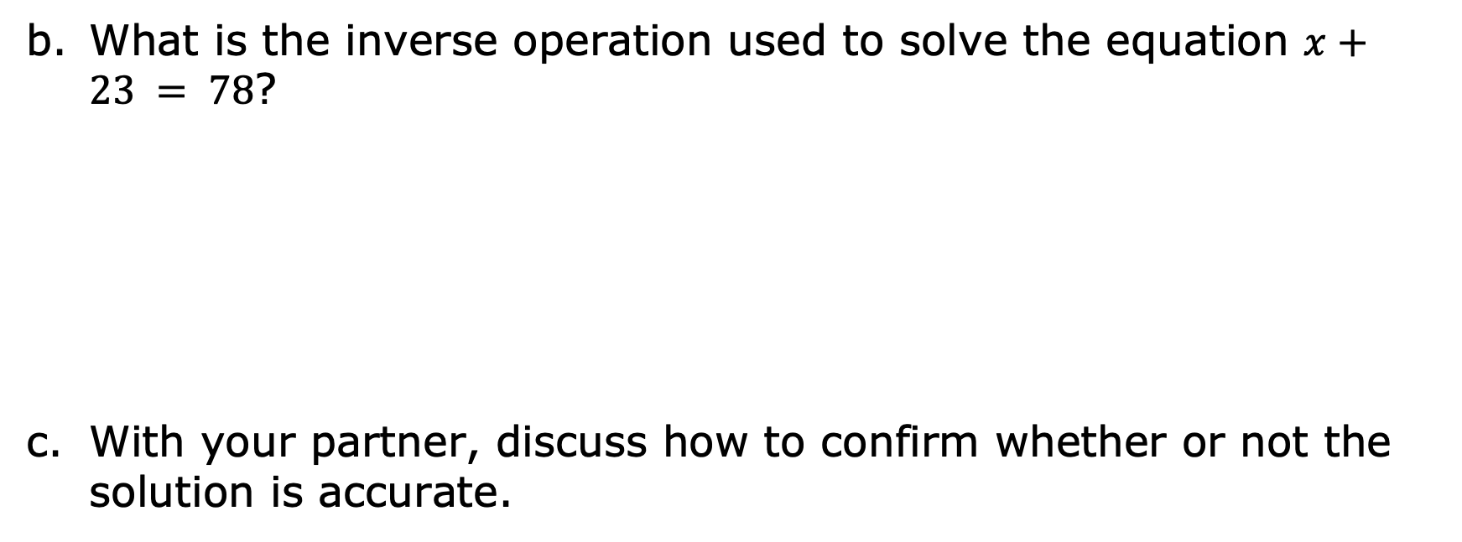
volume 2, pg. 315

Slide 18

Guided Practice
volume 2, pg. 316

Slide 19
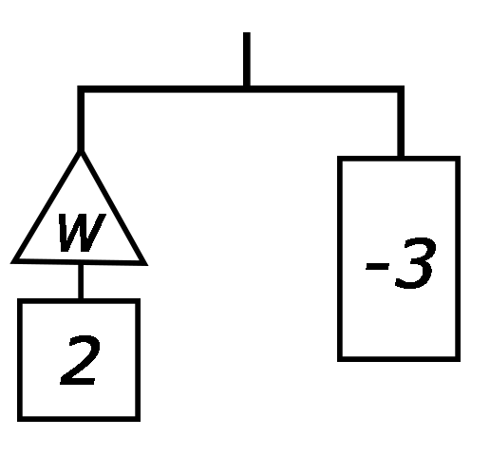
12.7.3 Guided Practice: Solving Equations with Inverse Operations
Work with your partner to complete the following.
An equation can also be represented using a balanced hanger. A hanger stays balanced when the weights on both sides are equal. As the weights are changed, the hanger will stay balanced as long as both sides are changed in the same way.
The hanger diagram represents a balanced equation because both sides of the hanger are level.
volume 2, pg. 316

Slide 20
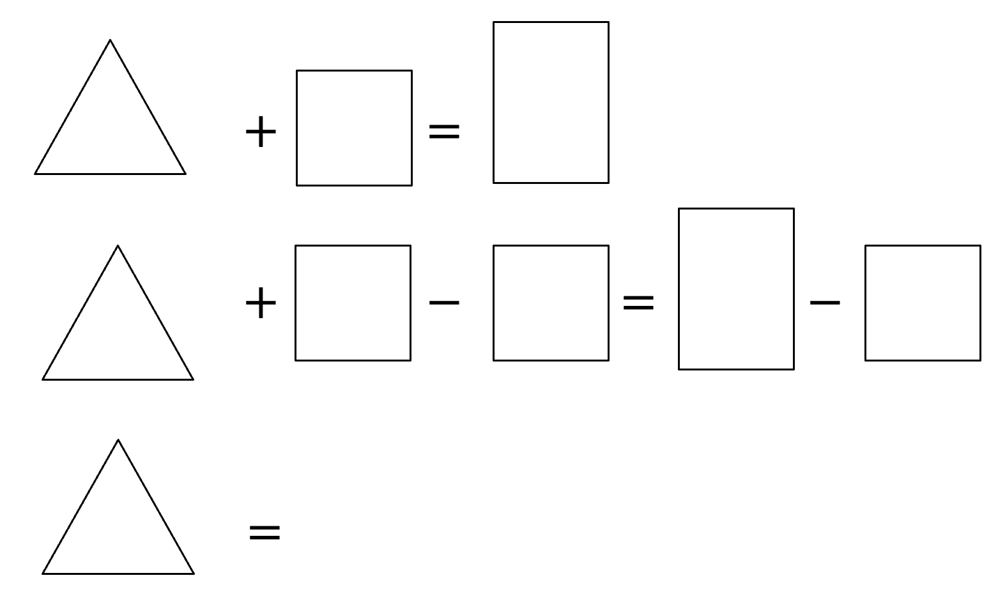
Fill in the values for each equation using the hanger diagram. Then, solve for the unknown value, 𝑤.
Rewrite the original equation replacing the variable, 𝑤, with the solution to check your work.
volume 2, pg. 316

Slide 21



The bar model represents an equation.
Write an addition equation represented by the bar model.
When solving an algebraic equation, the inverse operation can be applied to both sides of the equation. What inverse operation can be used to solve this equation?
volume 2, pg. 316

Slide 22
Write the equivalent equation using inverse operations.
What is the value of the variable, 𝑥?
volume 2, pg. 316

Slide 23
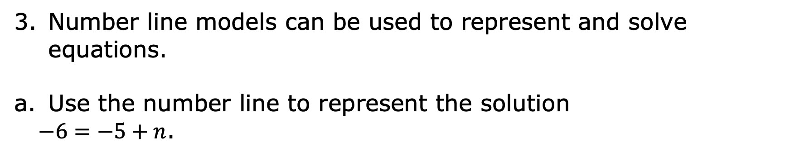
What is the value of the variable, 𝑛?
volume 2, pg. 317

Slide 24

Your Turn
volume 2, pg. 317

Slide 25
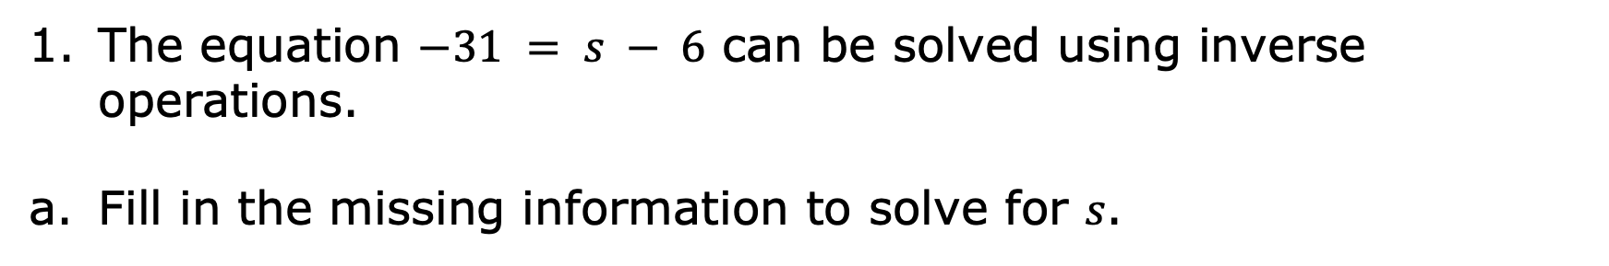
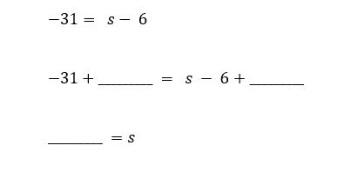
12.7.4 Your Turn!
volume 2, pg. 317

Slide 26
Which inverse operation was used to solve the equation?
Check your solution.
volume 2, pg. 317

Slide 27
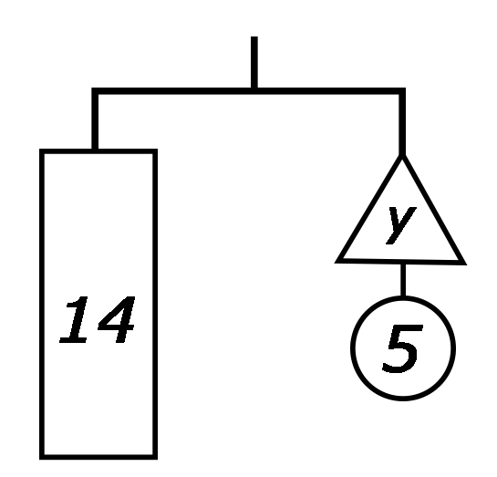
The hanger diagram represents an equation.
Write the equation represented by the hanger diagram.
What is the value of 𝑦?
volume 2, pg. 318

Slide 28
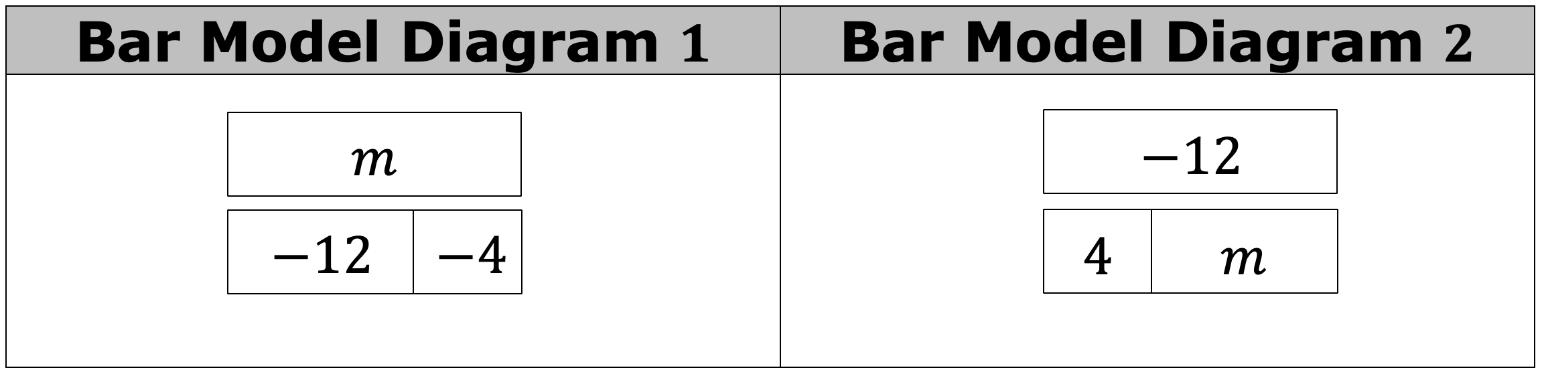
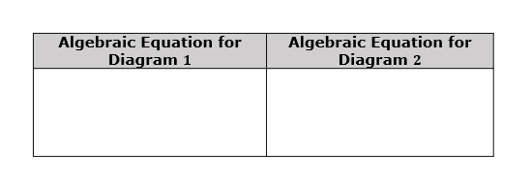
Two bar model diagrams are shown.
Write an algebraic equation for each diagram box diagram.
volume 2, pg. 318

Slide 29
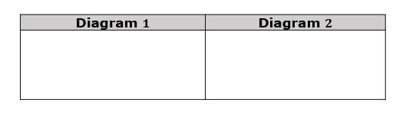
Find the value of variable, 𝑚, for each algebraic equation.
Discuss with your partner what you notice about the two equations. Summarize your discussion.
volume 2, pg. 318

Slide 30
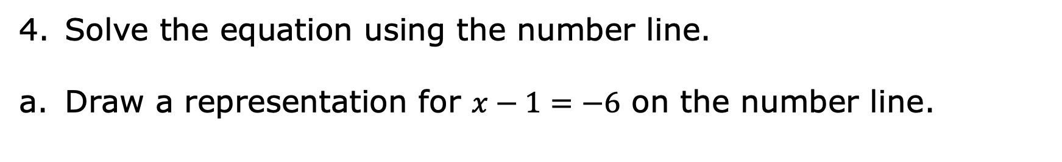
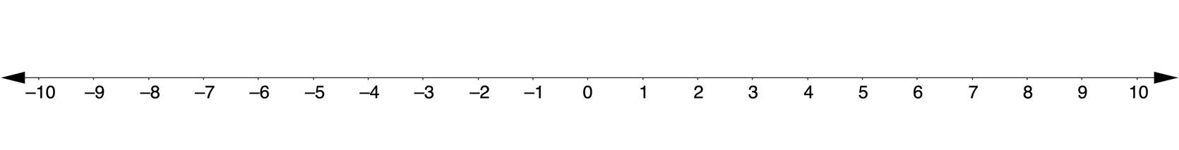
What is the value of the variable, 𝑥?
volume 2, pg. 319

Slide 31

Wrap-Up
volume 2, pg. 319

Slide 32
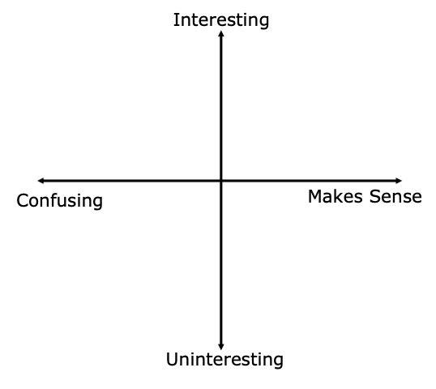
12.7.5 Wrap-Up: Reflection
Plot a point to indicate how you feel about today’s learning target: “I can use diagrams and inverse operations when solving one-step addition and subtraction equations.”
volume 2, pg. 319

